Slide 1
Organizational Culture and Environment
Management
Stephen P. Robbins Mary Coulter
tenth edition
Chapter
3

Slide 2
Learning Outcomes
Follow this Learning Outline as you read and study this chapter.
3.1 The Manager: Omnipotent Or Symbolic?
  Contrast the actions of managers according to the omnipotent and symbolic views.
  Identify the two constraints on managerial discretion.
3.2 Organizational Culture
  Identify the seven dimensions of organizational culture.
  Discuss the impact of a strong culture on organizations and managers.
  Explain how a culture is formed and maintained.
  Describe how culture affects managers.

Slide 3
Learning Outcomes
3.3 Current Organizational Culture Issues.
  Describe the characteristics of an ethical culture, an innovative culture, and a customer-responsive culture.
  Explain why workplace spirituality seems to be an important concern.
  Describe the characteristics of a spiritual organization.
3.4 The Environment.
  List the components of the specific and general environments.
  Explain the two dimensions of environmental uncertainty.
  Identify the most common organizational stakeholders.
  List the four steps in managing external stakeholder relationships.

Slide 4

The Manager: Omnipotent or Symbolic?
Omnipotent View of Management
  Managers are directly responsible for an organization’s success or failure.
  The quality of the organization is determined by the quality of its managers.
  Managers are held accountable
  for an organization’s performance,
  yet it is difficult to attribute
  good or poor performance
  directly to their influence
  on the organization.

Slide 5

The Manager: Omnipotent or Symbolic?
Symbolic View of Management
  Much of an organization’s success or failure is due to external forces outside of managers’ control.
  The ability of managers to affect outcomes is influenced and constrained by external factors.
    The economy, customers, governmental policies, competitors, industry conditions,
    technology, and the actions of
    previous managers
  Managers symbolize control and
  influence through their action.

Slide 6
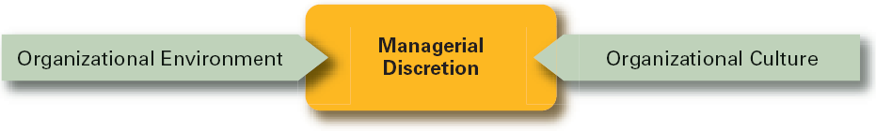
Exhibit 3–1 Parameters of Managerial Discretion

Slide 7

The Organization’s Culture
Organizational Culture
  A system of shared meanings and common beliefs held by organizational members that determines, in a large degree, how they act towards each other.
  “The way we do things around here.”
    Values, symbols, rituals, myths, and practices
  Implications:
    Culture is a perception.
    Culture is shared.
    Culture is descriptive.

Slide 8
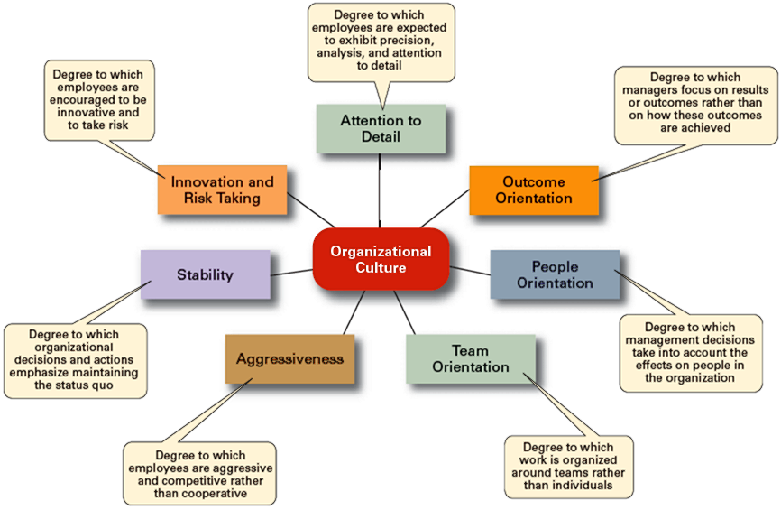
Exhibit 3–2 Dimensions of Organizational Culture

Slide 9
Strong Versus Weak Cultures
Strong Cultures
  Are cultures in which key values are deeply and widely held.
  Have a strong influence on organizational members.
Factors Influencing the Strength of Culture
  Size of the organization
  Age of the organization
  Rate of employee turnover
  Strength of the original culture
  Clarity of cultural values and beliefs

Slide 10
Exhibit 3–3 Contrasting Organizational Cultures
Dimension | Organization A | Organization B
Attention to Detail | High | Low
Outcome Orientation | Low | High
People Orientation | Low | High
Team Orientation | Low | High
Aggressiveness | Low | High
Stability | High | Low
Innovation and Risk Taking | Low | High

Slide 11

Benefits of a Strong Culture
Creates a stronger employee commitment to the organization.
Aids in the recruitment and socialization of new employees.
Fosters higher organizational
performance by instilling and
promoting employee initiative.

Slide 12
Organizational Culture
Sources of Organizational Culture
  The organization’s founder
    Vision and mission
  Past practices of the organization
    The way things have been done
  The behavior of top management
Continuation of the Organizational Culture
  Recruitment of like-minded employees who “fit”
  Socialization of new employees to help them adapt to the culture

Slide 13
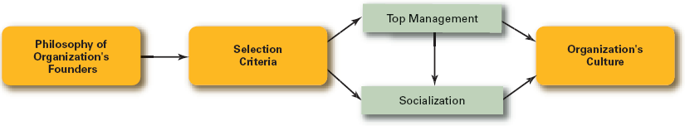
Exhibit 3–5 How an Organization’s Culture Is Established and Maintained

Slide 14
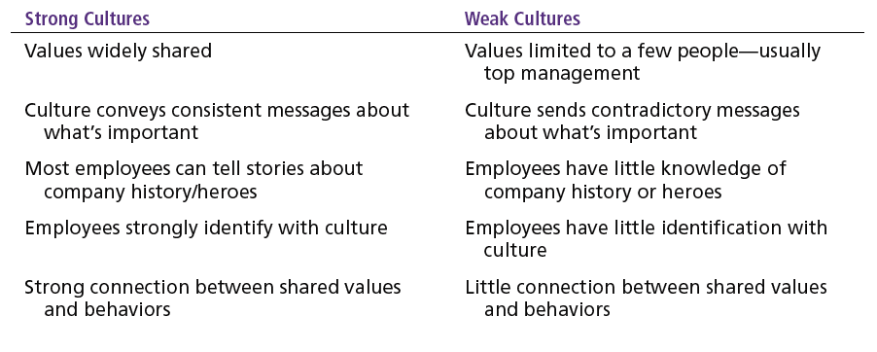
Exhibit 3–4 Strong Versus Weak Organizational
Cultures

Slide 15
How Employees Learn Culture
Stories
  Narratives of significant events or actions of people that convey the spirit of the organization
Rituals
  Repetitive sequences of activities that express and reinforce the values of the organization
Material Symbols
  Physical assets distinguishing the organization
Language
  Acronyms and jargon of terms, phrases, and word meanings specific to an organization

Slide 16
How Culture Affects Managers
Cultural Constraints on Managers
  Whatever managerial actions the organization recognizes as proper or improper on its behalf
  Whatever organizational activities the organization values and encourages
  The overall strength or weakness of the organizational culture
  Simple rule for getting ahead in an organization:
  Find out what the organization rewards and act accordingly.

Slide 17
Exhibit 3–6 Managerial Decisions Affected by Culture
Planning
  The degree of risk that plans should contain
  Whether plans should be developed by individuals or teams
  The degree of environmental scanning in which management will engage
Organizing
  How much autonomy should be designed into employees’ jobs
  Whether tasks should be done by individuals or in teams
  The degree to which department managers interact with each other

Slide 18
Exhibit 3–6 Managerial Decisions Affected by Culture
(cont’d)
Leading
  The degree to which managers are concerned with increasing employee job satisfaction
  What leadership styles are appropriate
  Whether all disagreements—even constructive ones—should be eliminated
Controlling
  Whether to impose external controls or to allow employees to control their own actions
  What criteria should be emphasized in employee performance evaluations
  What repercussions will occur from exceeding one’s budget

Slide 19
Organization Culture Issues
Creating an Ethical Culture
  High in risk tolerance
  Low to moderate aggressiveness
  Focus on means as well as outcomes
Creating an Innovative Culture
  Challenge and involvement
  Freedom
  Trust and openness
  Idea time
  Playfulness/humor
  Conflict resolution
  Debates
  Risk-taking

Slide 20
Exhibit 3–7 Creating a More Ethical Culture
Be a visible role model.
Communicate ethical expectations.
Provide ethics training.
Visibly reward ethical acts and punish unethical ones.
Provide protective mechanisms so employees can discuss ethical dilemmas and report unethical behavior without fear.

Slide 21
Organization Culture Issues (cont’d)
Creating a Customer-Responsive Culture
  Hiring the right type of employees (those with a strong interest in serving customers)
  Having few rigid rules, procedures, and regulations
  Using widespread empowerment of employees
  Having good listening skills in relating to customers’ messages
  Providing role clarity to employees to reduce ambiguity and conflict and increase job satisfaction
  Having conscientious, caring employees willing to take initiative

Slide 22
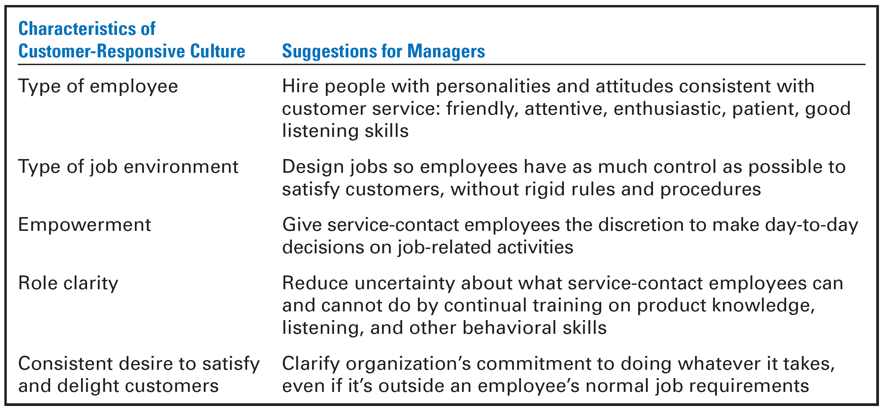
Exhibit 3–8 Creating a Customer-Responsive Culture

Slide 23
Spirituality and Organizational Culture
Workplace Spirituality
  The recognition that people have an inner life that nourishes and is nourished by meaningful work that takes place in the context of community.
Characteristics of a Spiritual Organization
  Strong sense of purpose
  Focus on individual development
  Trust and openness
  Employee empowerment
  Toleration of employees’ expression

Slide 24
Benefits of Spirituality
Improved employee productivity
Reduction of employee turnover
Stronger organizational performance
Increased creativity
Increased employee satisfaction
Increased team performance
Increased organizational performance

Slide 25
Defining the External Environment
External Environment
  Those factors and forces outside the organization that affect the organization’s performance.
Components of the External Environment
  Specific environment: external forces that have a direct and immediate impact on the organization.
  General environment: broad economic, socio-cultural, political/legal, demographic, technological, and global conditions that may affect the organization.

Slide 26
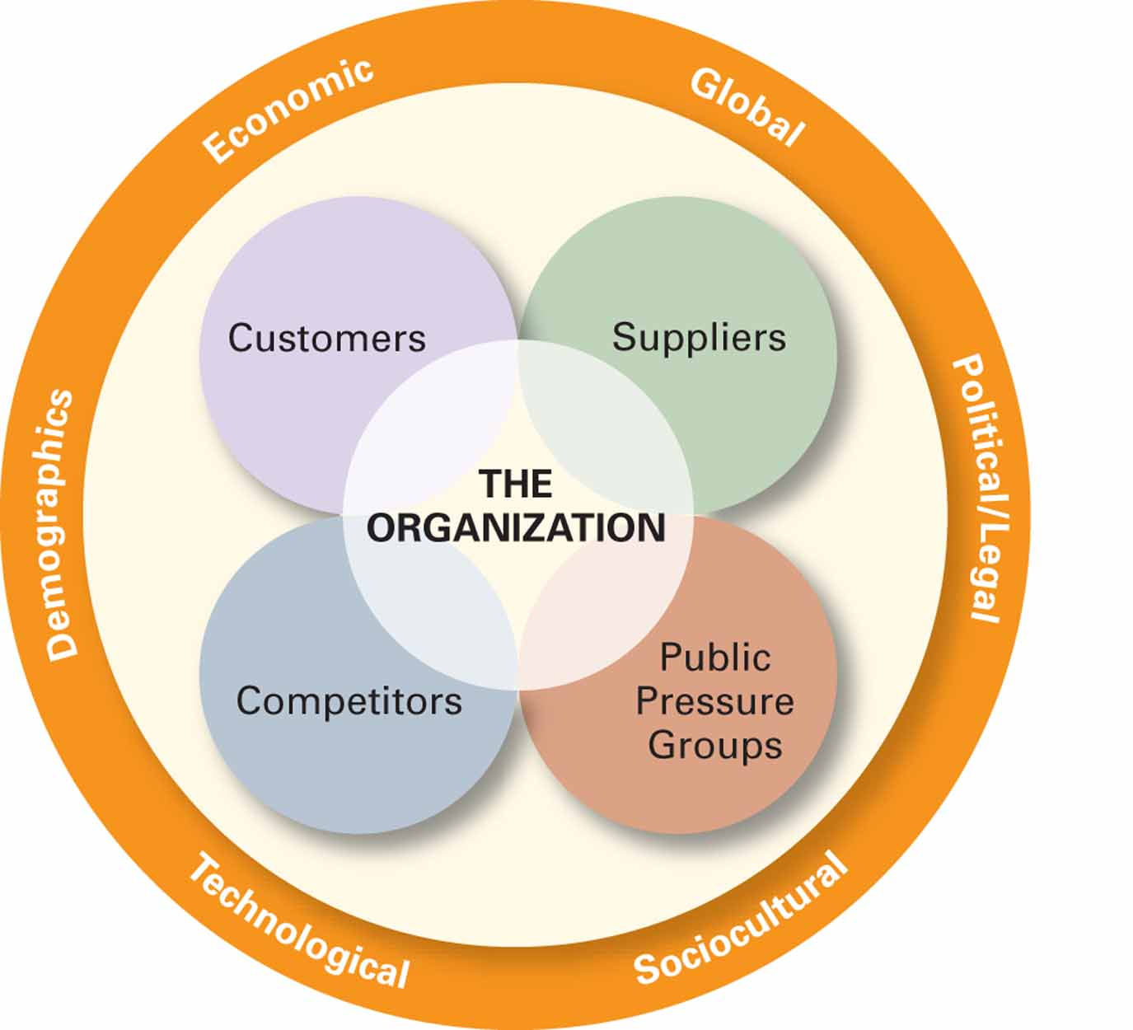
Exhibit 3–9 The External Environment

Slide 27
Exhibit 3–10 Important Legislation
Occupational Safety and Health Act of 1970
Consumer Product Safety Act of 1972
Equal Employment Opportunity Act of 1972
Worker Adjustment and Retraining Notification Act of 1988
Americans with Disabilities Act of 1990
Civil Rights Act of 1991
Family and Medical Leave Act of 1993
Child Safety Protection Act of 1994
U.S. Economic Espionage Act of 1996
Electronic Signatures in Global and National Commerce Act of 2000
Sarbanes-Oxley Act of 2002
Fair and Accurate Credit Transactions Act of 2003

Slide 28
How the Environment Affects Managers
Environmental Uncertainty
  The extent to which managers have knowledge of and are able to predict change their organization’s external environment is affected by:
    Complexity of the environment: the number of components in an organization’s external environment.
    Degree of change in environmental components: how dynamic or stable the external environment is.

Slide 29
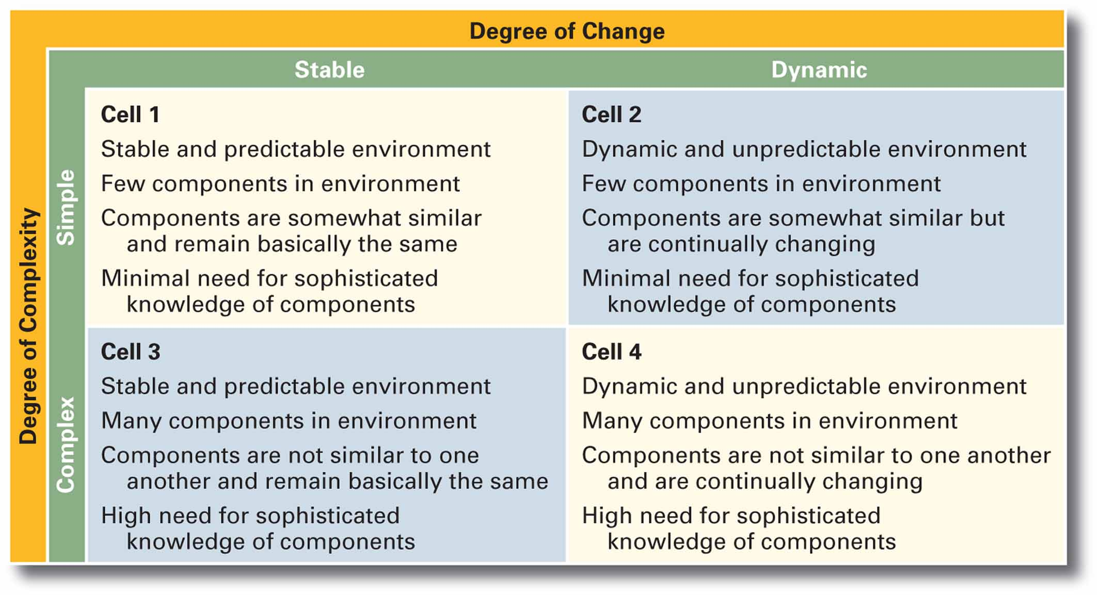
Exhibit 3–11 Environmental Uncertainty Matrix

Slide 30
Stakeholder Relationships
Stakeholders
  Any constituencies in the organization’s environment that are affected by the organization’s decisions and actions
Why Manage Stakeholder Relationships?
  It can lead to improved organizational performance.
  It’s the “right” thing to do, given the interdependence of the organization and its external stakeholders.

Slide 31
Managing Stakeholder Relationships
Identify the organization’s external stakeholders.
Determine the particular interests and concerns of the external stakeholders.
Decide how critical each external stakeholder is to the organization.
Determine how to manage each individual external stakeholder relationship.

Slide 32
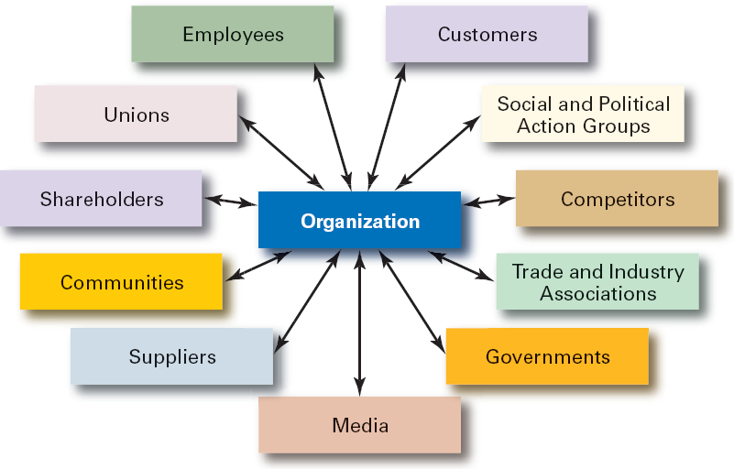
Exhibit 3–12 Organizational Stakeholders

Slide 33
Terms to Know
omnipotent view of management
symbolic view of management
organizational culture
strong cultures
socialization
workplace spirituality
external environment
specific environment
general environment
environmental uncertainty
environmental complexity
stakeholders

Slide 34

All rights reserved. No part of this publication may be reproduced, stored in a retrieval system, or transmitted, in any form or by any means, electronic, mechanical, photocopying, recording, or otherwise, without the prior written permission of the publisher. Printed in the United States of America.

